Slide 1
The application of ALT to EMR (henceforth “David-ing the EMR”)

Slide 2

What we will cover:
Why train at all
Brief reminder of Adult Learning Theory
How it applies to EMR Training
Principles of EMR Training
Physicians as a unique group
Notes:
Very little research on training EMRS

Slide 3
Importance of Technical Assistance and Training
Improved training and technical support (Ryan)
EHR implementation did not improve patient care quality
Addition of training and support did
Still took 9 months
Improves skills and new ways of thinking (Brusco)
Independence
Self-direction
Increases clinical information sharing
Enforces standardization
Faster achievement of self efficacy (Bauer)
Training impacts the view of the entire organization (Abdinnour-Helm)
-Ryan, A.M., et al., Small physician practices in new york needed sustained help to realize gains in quality from use of electronic health records. Health Aff (Millwood), 2013. 32(1): p. 53-62.
-Brusco J. (2011). Electronic health records: What nurses need to know. AORN Journal, 93(3), 371-380
-Bauer T. N. (2010). Onboarding new employees: Maximizing success. Sponsored by Right Management. Society for Human Resources Management Foundation.
-Abdinnour-Helm, Sue & Lengnick-Hall, Mark L. & Lengnick-Hall, Cynthia A., 2003. "Pre-implementation attitudes and organizational readiness for implementing an Enterprise Resource Planning system," European Journal of Operational Research, Elsevier, vol. 146(2), pages 258-273, April.

Slide 4
A reminder of what is “Adult Learning Theory”
Based on Malcolm Knowles works in the 1980s-1990s
Adapted in the mid 1980s as human resources platform
Widely studied and generally accepted
Multiple studies show improvement of training with adherence to the foundation of ALT

Slide 5
A reminder of what is “Adult Learning Theory”
Need to know: Adults need to know the reason for learning something.
Foundation: Experience (including error) provides the basis for learning activities.
Self-concept: Adults need to be responsible for their decisions on education; involvement in the planning and evaluation of their instruction.
Readiness: Adults are most interested in learning subjects having immediate relevance to their work and/or personal lives.
Orientation: Adult learning is problem-centered rather than content-oriented.
Motivation: Adults respond better to internal versus external motivators.

Slide 6
Knowles application to computer training
There is a need to explain the reasons specific things are being taught (e.g., certain commands, functions, operations, etc.)
Instruction should be task-oriented instead of promoting memorization -- learning activities should be in the context of common tasks to be performed by the others.
Instruction should take into account the wide range of different backgrounds of learners; learning materials and activities should allow for different levels/types of previous experience with computers.
Since adults are self-directed, instruction should allow learners to discover things and knowledge for themselves without depending on people. However, learners should be offered guidance and help when mistakes are made.

Slide 7
Application of ALT to EMR
Do not just train what to do, train why they need to know the information
Use the trainees past experiences as a RESOURCE not as a BARRIER
Include trainees in the process and responsibility for self-directed learning
Trainees will retain when lessons are timely and relevant and will be immediately applicable
Training should be problem-oriented towards solving issues that apply to their work scenarios
Trainees are motivated to learn content without other drivers IF the other needs are applied

Slide 8
Toth’s Principles of EMR Training
Training cannot be done in isolation
Training requires meticulous planning
Training has to happen at the right time
Training requires careful use of multiple modalities
Training must be goal-oriented
Training requires end-user involvement
Training cannot waste a users time
Training must maintain function over form
Training is not a one-time event

Slide 9
Training is not done in isolation
EMR training is Sociotechnical system problem, NOT a program problem (He)
EMRs are not used in isolation so should not be taught in isolation
Initial EMR training should be tied to the larger onboarding process (Bauer)
Leader Commitment, Training, Coaching, Support Tools, Feedback
Self-Efficacy + Role Clarity + Social Integration + Knowledge of Culture
Results: (Burger)
Higher job satisfaction
Lower turnover
Improved performance
Lowered burnout
He, Z., J. Marquard, and E. Henneman, Model Guided Design and Development Process for an Electronic Health Record Training Program. AMIA Annu Symp Proc, 2016. 2016: p. 1814-1821.
Burger, J., & Giger, A. (2014, February 13). How healthcare organizations can improve this year. http://www.gallup.com/businessjournal/167108/healthcareorganizations-improve-year.aspx

Slide 10
Training Requires Meticulous Planning

Slide 11
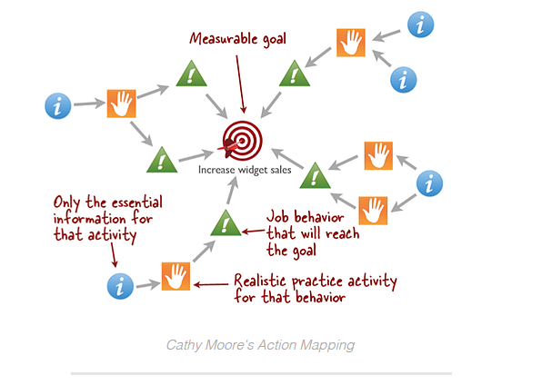
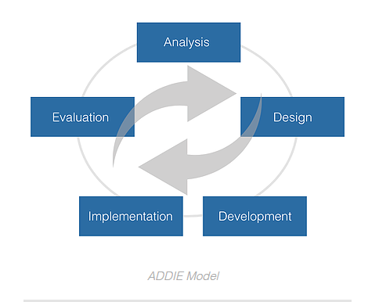
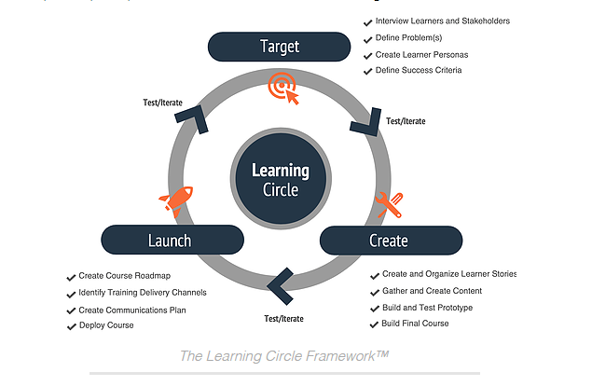
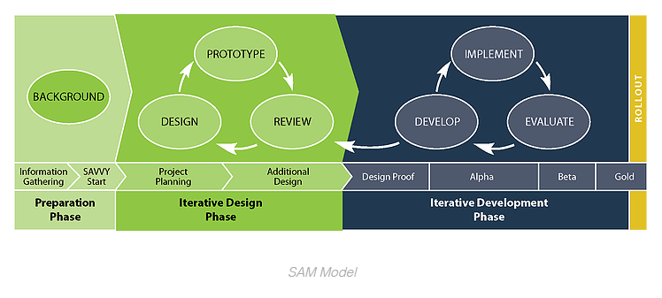
Training Models
Notes:
ADDIE model was the most commonly used process in the limited research.
The SAM model has more feedback mechanisms, so AMIA suggested a modified model.

Slide 12
AMIA Modified EMR Training Model
Analysis
Implement
Design
Testing
Development
Evaluate

Slide 13
Analysis
Goals
Stakeholders
Training characteristics
Clinical tasks
EHR integration
Resources, constraints, and suitability
Analysis
Design
Implement
Testing
Development
Evaluate

Slide 14
Training Goals Analysis
Identify a need (or problem)
Needs should be based primarily on evaluation and end-user feedback
Patient -> User -> Organizational-based need?
How does this need align with mission, vision, and values?
Determine the goal to meet that need
(SMART) - Specific, Measurable, Achievable, Relevant, Time-bound
Clear objectives improve motivation and retention (Locke, Wentland)
The problem should be clearly stated for the trainee
The benefits of training should be clearly stated (Lieb)
Primarily “what is the benefit for the patient”
Secondarily “what is the benefit for the trainee”
Finally “what is the benefit for the organization”
*if you cannot answer the first two do not bother with the third*
Locke, E. A., & Latham, G. P. (2006). New directions in goal-setting theory. Current Directions in Psychological Science, 15(5), 265-268.
Wentland, D. (2003). The strategic training of employees’ model: balancing organizational constraints and training content. SAM Advanced Management Journal, 68(1), 56-64
Lieb, S., & Goodlad, J. (2005). Principles of adult learning.
Notes:
Although the GOALS can be organizational, the BENEFIT cannot only be organizational
*It is probably a process problem, not a training problem

Slide 15
Stakeholders Analysis
EMR is ALWAYS multidisciplinary
The primary stakeholder is the trainee
... but the primary beneficiary should always be the patient
Trainees are the ones being asked for a change
Consider the upstream and downstream effects (whom and what will be affected?)
Problem
Solution
Trainee Characteristics
Account for current competencies
Match the training to the user needs
The primary stakeholder (e.g. the trainee) must “participate extensively in the development process”
Should identify stakeholder super-users at this stage
He, Z., J. Marquard, and E. Henneman, Model Guided Design and Development Process for an Electronic Health Record Training Program. AMIA Annu Symp Proc, 2016. 2016: p. 1814-1821.

Slide 16

Stakeholder Analysis (Obtaining buy-in)
Rapport with instructors, perceived capability of learning, and recognizing information is vital to their job improves learning (Colquitt)
Verbal persuasion and emotional connections improve value
Stakeholders must believe they will achieve valued learning (Kirk)
Colquitt, J. A., LePine, J. A., & Noe, R. A. (2000). Toward an integrative theory of training motivation: A meta-analytic path analysis of 20 years of research. The Journal of Applied Psychology, 85(5), 678-707.
Kirk, K. (2013). Self-efficacy: Helping students believe in themselves. Retrieved from http://serc.carleton.edu/NAGTWorkshops/affective/efficacy.html
Notes:
Charisma and social skills may matter more than technical expertise (for training effectiveness).

Slide 17
Training Characteristics Analysis
Passive Transfer
Best for data chunking, time constraints
Requires repetition
Examples:
Shadowing
Presentations/demonstrations
Documentation
Active Transfer (experiential)
Best for retention & sustained change
Examples:
Mentoring
Hand-on training/ interactive
Simulations/social learning
Notes:
Data chunking refers to trying to transfer large amounts of information at once, like group-wide training in an auditorium or a lecture. Another way to think of it is teaching without context – giving a lecture on a UTI, vs walking a medical trainee through the care of an actual patient with a UTI.

Slide 18
Training Characteristics Analysis
Best when a combination of modalities is possible
Passive transfer reinforced by active transfer (see-do)
Active transfer reinforced by passive transfer (tip-sheets)
Adult Learning HIGHLY favors active transfer whenever feasible
More pronounced in Electronic Medium Modalities
Key to determining type of training:
Consider the problem
Consider the goal of the training
Consider the trainees needs
Only use passive transfer when active transfer is not feasible
Otherwise both should be used
Notes:
Live passive transfer after 15 minutes goes way down (so intersperse lectures with active transfer).
Online passive transfer (e.g. CBTs) goes down after only 6 minutes.
TIMING IS IMPORTANT.

Slide 19
Clinical Task & Functional Analysis
Start with the process of interest NOT technical skills
Get to the WHY instead of the WHAT
What is the functional impact on the trainee
What is actually being asked during the training
What is being asked by the training
Map the trainees:
Role in that process
Responsibility in that process

Slide 20
Clinical Task & Functional Analysis
Instruct from the current process that is familiar
What is getting done
What needs to get done
The change that is required
THE NUMBER ONE CAUSE OF INNEFECTIVE TRAINING?
Overloading the trainee with irrelevant information

Slide 21
Integration/Workflow Analysis
EMR use is a Sociotechnical issue
Needs a Sociotechnical solution
What is the cognitive load/feasibility of the training requirements
What is the impact of this training on the workflow?
On the trainee
On other stakeholders

Slide 22
Resources, Constraints, and Suitability
What tools should be required to optimize the training
How long should the training take
Depends on the modality
ie – videos more than 6 minutes less effective
Over 18 minutes of lecture diminutive return
Improves with interruptive active modalities
Worse when “relevance to trainee” is low
Incorporating user (Super-Users) into the training
Will training as outlined be the most effective?
Is this training needed at all?

Slide 23
Design + Development + Testing
Iterative process
WHAT (content) and HOW (Process)
Ongoing evaluation by Primary Stakeholders
Especially trainee representative (super-user)
Analysis
Design
Implement
Testing
Development
Evaluate

Slide 24
Implement
Timing is everything
Right time allows trainees to USE the training immediately
Good training will not be effective if done at the wrong time
Analysis
Design
Implement
Testing
Development
Evaluate

Slide 25
Evaluate
Measurement takes TIME + RESOURCES = $$$
But so does training
Training programs must deliver the expected benefit
Patients – Users – Organization
Consider the PURPOSE of the evaluations
Allows for re-analysis of training to restart the process
Learners appreciate when feedback impacts future training (Lieb)
Evaluation technically STARTS and STOPS all training
Analysis
Design
Implement
Testing
Development
Evaluate

Slide 26
Kirkpatrick Model of Evaluating Effectiveness
Level 1: Reaction
To what extent did the participants find the training useful, challenging, well-structured, and organized?
Level 2: Learning
To what extent did participants improve knowledge and skills and change attitudes?
Level 3: Behavior
To what extent did participants change their behavior back in the workplace?
Level 4: Results
What measurable organizational benefits resulted from the training in terms such as productivity, efficiency and revenue
Analysis
Design
Implement
Testing
Development
Evaluate
Notes:
Kirkpatrick is probably the most well-known method.
All levels are important, but costs and time needed for measuring increases with each subsequent level.

Slide 27
A reminder of what is “Adult Learning Theory”
Need to know: Adults need to know the reason for learning something.
Foundation: Experience (including error) provides the basis for learning activities.
Self-concept: Adults need to be responsible for their decisions on education; involvement in the planning and evaluation of their instruction.
Readiness: Adults are most interested in learning subjects having immediate relevance to their work and/or personal lives.
Orientation: Adult learning is problem-centered rather than content-oriented.
Motivation: Adults respond better to internal versus external motivators.

Slide 28
Toth’s Principles of EMR Training
Training cannot be done in isolation
Training requires meticulous planning – 1, 2, 3, 4, 5, 6
Training has to happen at the right time – 4
Training requires careful use of multiple modalities – 1, 2, 5
Training must be goal-oriented – 1, 3, 4
Training requires end-user involvement – 1, 3, 4
Training cannot waste a users time – 3, 6
Training must maintain function over form – 3, 5
Training is not a one-time event - 2
Notes:
Numbers refer to the Adult Learning principles on the previous slide.

Slide 29
Toth’s Principles of EMR Training
Adult Learning Principles
Need to know
Foundation
Self-concept
Readiness
Orientation
Motivation
Training cannot be done in isolation
Training requires meticulous planning – 1, 2, 3, 4, 5, 6
Training has to happen at the right time – 4
Training requires careful use of multiple modalities – 1, 2, 5
Training must be goal-oriented – 1, 3, 4
Training requires end-user involvement – 1, 3, 4
Training cannot waste a users time – 3, 6
Training must maintain function over form – 3, 5
Training is not a one-time event - 2
Notes:
Simply showing slides 27-28 side by side

Slide 30
Best Practices for initial EMR Training:
Identify computer skill and supplement with basic training
Identify and USE the super-users
Train ONLY on areas the user is going to use
Conduct post-implementation feedback
Use on-line vendor resources
Loria, Gaby. “Five Best Practices for Training Staff on Using a New EHR”. Software Advice.
Notes:
Post-implementation starting weekly

Slide 31
Specific Physician Recommendations
Physicians represent a unique group of end-users
Distinct recommendations are not only recommended but essential
Almost 50% of physician rate training as “less than adequate”
95% believed EMR skills could be improved

Slide 32
Physician Engagement
Engage the medical staff in the target organizational change
include key physicians to inform the software configuration, testing, and training process
“physician champions” are usually funded via a reduction in their clinical time, which can vary from 10–50% full time equivalents (FTE)
physician provided essential review of clinical context (training patients, training scenarios) and knowledge of institutional workflows (e.g. number of distinct provider workflows, how to group providers in class)
The timing, duration and structure of the EMR training should be communicated in advance to the medical staff

Slide 33
Timing
training classes should be offered 2 to 8 weeks prior to the change
greater than 8 weeks in advance will likely not be remembered
one-to-two week prior to go-live is recommended for emergent rescheduling/make-up sessions, remediation, personalization and use of a practice domain

Slide 34
Learner Groups
consider the number of distinct workflows in the population
repetition of a more general class will allow the trainers to master the delivery of content, improving quality and consistency of core concept delivery during classroom events
coursework should be designed to group learners by common workflow

Slide 35
Ensuring Clinical Relevance
Create practice patients for the EMR training domain which mirrors those seen by medical staff throughout the institution
curriculum should then be delivered through the lens of relevant practice patients
scenarios should mimic the learner’s workflow
Independent exercise with a practice patient and scenario consistent with their sub-specialty practice improve relevance

Slide 36
Content Delivery
previous EMR experience of the end-users should be considered in order to determine the appropriate duration and delivery of content
the classroom can be the best place to maintain interaction/enthusiasm, provide individualized assistance, assess competency and create a remediation plan

Slide 37
Other Considerations
Instructors with a clinical background was particularly well-received by the learners due to their understanding of the larger clinical context
Assessment
Exam-based assessment
Demonstration-based assessment
Addition of CMEs improved overall perception of training
Pantaleoni, J.L., et al., Successful physician training program for large scale EMR implementation. Appl Clin Inform, 2015. 6(1): p. 80-95.

Slide 38
Post-Implementation Training
More likely to appropriately use the EHR
Clear preferences for continued training
Improved satisfaction with EHR
Bredfeldt CE, Awad EB, Joseph K, Snyder MH. Training providers: beyond the basics of electronic health records. BMC Health Serv Res. 2013;13:503. Published 2013 Dec 2. doi:10.1186/1472-6963-13-503

